Slide 1

NCSG Meeting
ICANN 76: 12 March 2023
What are Closed Generics and How is the Closed Generics Small Group doing?
Question from Board to NCSG (and all other Stakeholder Groups meeting with them).

Slide 2
NCSG Meeting
ICANN 76: 12 March 2023
What are Closed Generics and How is the Closed Generics Small Group doing?
Board Question for NCSG (and all other Stakeholder Groups meeting with them)

Slide 3
NCSG Meeting
ICANN 76: 12 March 2023
What are Closed Generics & A Brief History
Closed Generics Small Group – GNSO, GAC & ALAC
(A Small Group working together)

Slide 4
1) What are Closed Generics &
A Brief History

Slide 5
Closed Generics are a strange exception to the general ICANN rule that:
Registrars -> sell Domain Names to Registrants gTLD Registries -> sell Domain Names to Registrars

Slide 6
Most gTLDs are open:
.com, .org, .net
.xyz, .horse, .vip, .club
A few “Brand gTLDs” we agreed could be “closed,” e.g.,
.sony, .ibm, .panasonic

Slide 7
But in 2012, the largest companies in the world applied for some new “Closed Generic” gTLDs
“Closed Generic” gTLD, at the time, was the “generic word” of a business, industry, organization or thing, applied for by one business, to be run solely for that one business.
.BLOG (Google) | .CARS
.CLOUD (Google and Amazon) | .FLOWERS
.SEARCH (Google) | .BEAUTY
APP (Google and Amazon) | .HAIR
.MOBILE (Dish DBS and Amazon) | .MAKEUP
.BOOK (Amazon) | .JEWELRY

Slide 8
The Community Objected…
One example from our Noncommercial
Community

Slide 9

https://www.thehindu.com/opinion/op-ed/beauty-lies-in-the-domain-of-the-highest-bidder/article3929612.ece

Slide 10
2012-2022:
1. Board banned Closed Generic applications in 2012 round. (Options for closed generic applicants in 2015: change your application to “open,” withdraw or wait for next round)
➔ Almost everyone changed to an open gTLD.
2. Subsequent Procedures PDP Working Group worked for four years on this issue (2016-2020)
➔ SubPro Working Grup could not arrive at any consensus – widely divergent views
3. In 2022, Board asked GNSO Council and GAC if they would meet in a Small Group (ALAC too) to find a path forward.
➔ GNSO, GAC and ALAC said yes!

Slide 11
Closed Generics Small Group
- Meeting by phone since Fall 2022.
- Met in person in DC, January 26-27, 2023
- Trying to find a path forward on this difficult issue
➔ “A Framework”
- Issued 3 Reports to share our work (thus far) with the ICANN Community

Slide 12
Closed Generics Small Group
- We have issued 3 short reports since starting to share our work with the ICANN Community.
- From these reports, I have some clips…

Slide 13
“The objective of the facilitated dialogue on closed generic gTLDs is to formulate a workable framework to identify and handle closed generic applications for the next round(s) of new gTLDs.
Should the participants from the GAC, GNSO, and ALAC reach agreement on a framework that meets with approval from the GAC and GNSO Council, the expectation is for the framework to be further developed through the appropriate GNSO policy process.” [italics added]

Slide 14
“In pursuit of agreement on what a framework for closed generic gTLDs should include, dialogue participants have so far held eight virtual meetings, worked asynchronously on various brainstorming exercises, and most recently engaged in a hybrid meeting in Washington DC, USA, on 26-27 January 2023.
During this hybrid meeting, participants discussed several key topics and definitions, brainstormed ideas for potential application and evaluation criteria, and collaborated in breakout and plenary sessions.”

Slide 15
“The group considered whether an applicant for a closed generic gTLD should have to demonstrate that there is a unique need for such a gTLD in its application. Participants generally agreed that an applicant must explain why a closed generic gTLD is necessary in order to operate in the manner they propose…”

Slide 16
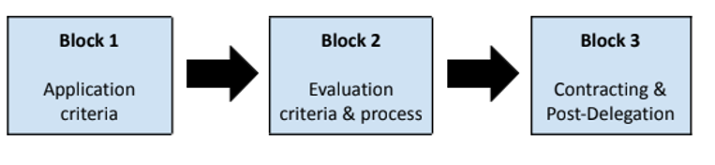

Slide 17
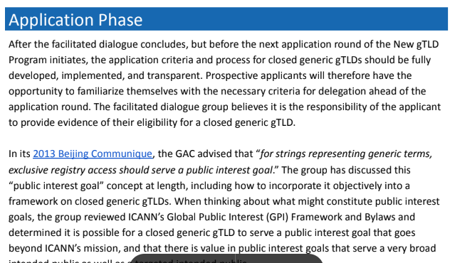

Slide 18
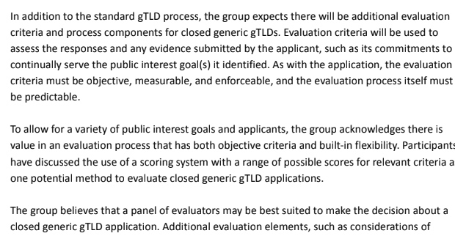

Slide 19
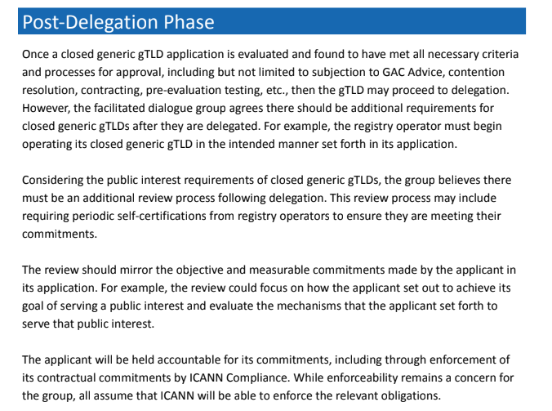

Slide 20
NCSG Meeting
ICANN 76: 12 March 2023
What are Closed Generics and How is the Closed Generics Small Group doing?
Board Questions: Board Question for NCSG (and all Stakeholders Groups)

Slide 21
Question from ICANN Board to Us:
“The ICANN Board would like to explore how to combine the efficiencies of an agile approach to problem solving, like the Council’s small teams, with the need for accountability and transparency, to make progress on policy conversations. When would such an approach be most appropriate and how can we ensure that it does not circumvent required steps in a policy development process?”
➔ What does the question mean?
➔ What do we think? Discussion!

Slide 22
If we have time: Our NCSG Question to the Board on Applicant Support:
“Applicant Support is a topic dear to the heart of NCSG. The SubPro ODP [Operational Design Phase- an ICANN Staff assessments with reports to Community] suggested that the applicant support program start 18 months prior to the anticipated opening of the application submission period. The ODA also offered 2 options for implementing SubPro outputs, where option 2 would only require 18 months of implementation. While the GGP continues its work, it seems impossible to incorporate the Applicant Support Program in time for the next round in the aggressive timeline of
Option 2… [continued next slide].

Slide 23
Our Question to the Board on Applicant Support:
… We appreciate the org's effort in mitigating risks and enhancing efficiency by developing option 2, but the NCSG feels strongly that the next round will be unfair if we open it without a meaningful and genuinely effective applicant support program.”
➔ Can we ask the Board to start the marketing process earlier than 18 months? Indigenous tribes and other minority groups (noncommercial groups) need more time to prepare!
➔ Indigenous peoples/minority groups need time to evaluate “big picture issues: resources for education, infrastructure (physical) vs. new gTLDs.
➔ If ICANN approaches these groups early, then they may be ready to move forward when details of Applicant Support and New gTLD Applicant Guidebook are finalized (about 18 months before next round opens).

Slide 24
Thank you for our discussion and have a good meeting!

